Slide 1
Econ 210a: Modern Economic Growth (February 26, 2020a)
J. Bradford DeLong
Spring 2019
Evans 648
W 1:10-3:00 pm
<https://bcourses.berkeley.edu/courses/1487686/>
<https://github.com/braddelong/public-files/blob/master/econ-210a-lecture-6a.pptx>

Slide 2
Modern Economic Growth
The four key numbers in this course are: 0.04, 0.15, 0.44, 2.06—the annual percentage growth rates h of the useful-ideas stock in the Post-Writing Agrarian, Commercial Revolution, Industrial Revolution, and Modern Economic Growth Eras. (Or perhaps 0.05, 0.2, 0.9, 2.3—the numbers for “the Advanced West”.) But is it really best thought of as 2.06 (or 2.3)? And why is it so much bigger than 0.44 (or 0.9)?:
Readings:
William D. Nordhaus (1997): Do Real-Output and Real-Wage Measures Capture Reality? The History of Lighting Suggests Not <http://www.nber.org/chapters/c6064>
Robert Gordon (2000): Interpreting the “One Big Wave” in Long-Term Productivity Growth <https://www.nber.org/papers/w7752.pdf>
Peter Thompson (2001): How Much Did the Liberty Shipbuilders Learn? New Evidence for an Old Case Study <http://www.jstor.org/stable/pdfplus/10.1086/318605.pdf>

Slide 3
Let’s Look at the Dual…
With prices and expenditure shares, it would seem that the calculation of economic growth is very easy:
With perfect competition, the price decline is the TFP increase…
Multiply expenditure shares by the price decline, and you get the savings: how much less it takes you this year to attain last year’s consumption bundle
The wedge between income growth and expenditure-weighted price declines is then economic growth: how much of additional resources do you have this year?
Problems:
Whose expenditure shares?
What about expansions in the set of producible goods—things whose prices fall from ∞, where we do not observe the initial stages of the fall
“Spite” & “envy” effects—also “hits”
How do we become who we are?

Slide 4
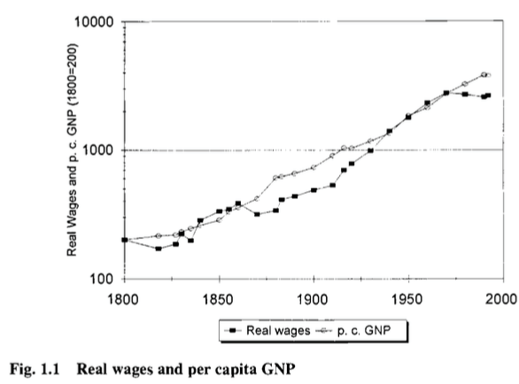
Reading Nordhaus
William D. Nordhaus (1997): Do Real-Output and Real-Wage Measures Capture Reality? The History of Lighting Suggests Not <http://www.nber.org/chapters/c6064>:
Conventional measures: a 15-fold increase in real first-world GDP/capita and productivity since 1800 or so…

Slide 5
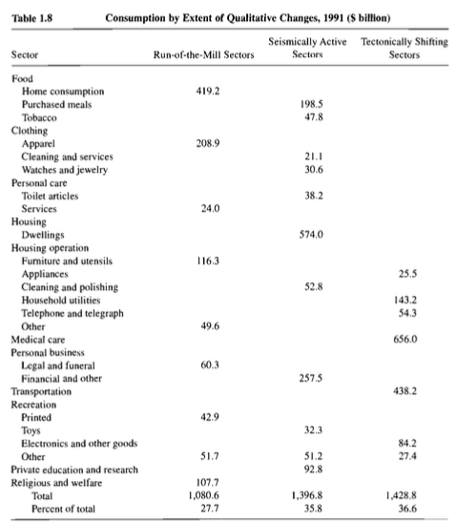
Bill Nordhaus: Rocket Ship to the Singularity?
A 20-fold or a 30,000-fold increase in real wages in the North Atlantic since 1800?
Nordhaus calculates that—back in 1991—28% of consumption was “run-of-the-mill”, 36% had been “seismically-active” since 1800, and 37% was in sectors that had no effective affordable equivalent in 1800
Dixit-Stiglitz tells us that we multiply “ordinary” utilities by the number of varieties. Which way does that mislead us?

Slide 6
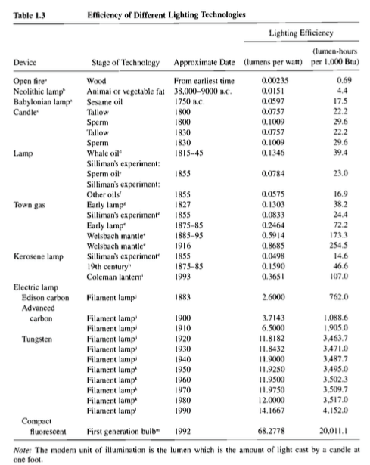
Bill Nordhaus: Rocket Ship II
A 5000-fold decrease in the price of light since 1800
This is something that churned up between 1% and 5% of household budgets back in 1800
100-fold CPI bias in the price of light since 1800

Slide 7
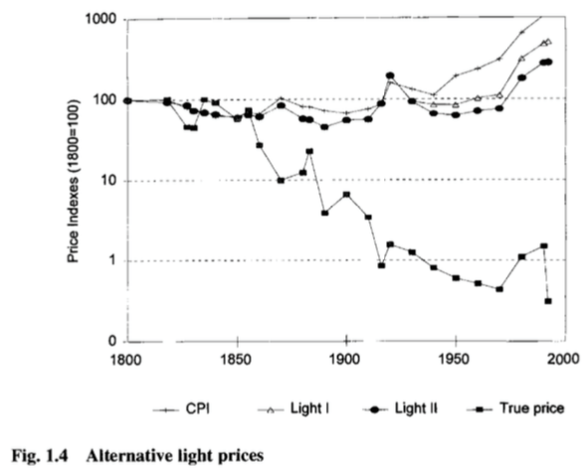
Bill Nordhaus: Rocket Ship III

Slide 8

“Do You Like Music?”
Perhaps a better way than doing math in which to grasp the magnitude of the contribution that the changing set and mass of goods and services we can produce makes to our wealth is by reading Looking Backward, Edward Bellamy’s 1887 utopian novel. In Looking Backward the narrator—thrown forward in time from 1895 to 2000 by an unbelievable and crude plot device.
He hears the question (p. 87): “Are you fond of music?”
He expects his hostess to play the piano—a social accomplishment of upper-class women around 1900. To listen to music on demand then, you had to have—in your house or nearby—an instrument, and someone trained to play it. It would have cost the average worker some 2400 hours, roughly a year at a 50-hour workweek, to earn the money to buy a high-quality piano, and then there would be the expense and the time committed to piano lessons.
But today, to listen to music-on-demand in your home, all you need is… your smartphone…

Slide 9

Labor-Time Values
The labor-time value of a Steinway piano has fallen in price from 2400 average worker-hours a century ago to 1100 average worker-hours today. But if what you value is not the piano itself but the capability of listening to music at home, the cost has fallen from 2400 average worker-hours a century ago to… what?
Maybe 10 hours?
So when we calculate the increase in material wealth, do we count the halving of the labor-time price of the commodity (which is what Historical Statistics does); or do we count the 240-fold decrease in the real labor-time price of the capability of listening to piano music? The experiences of live and recorded music are different in kind. But are they different enough to put a serious dent in the fact that a household today can acquire the capability of listening to piano music for only 1/240 the labor time cost of a household of a century ago? And whose piano playing do you really want to listen to?

Slide 10
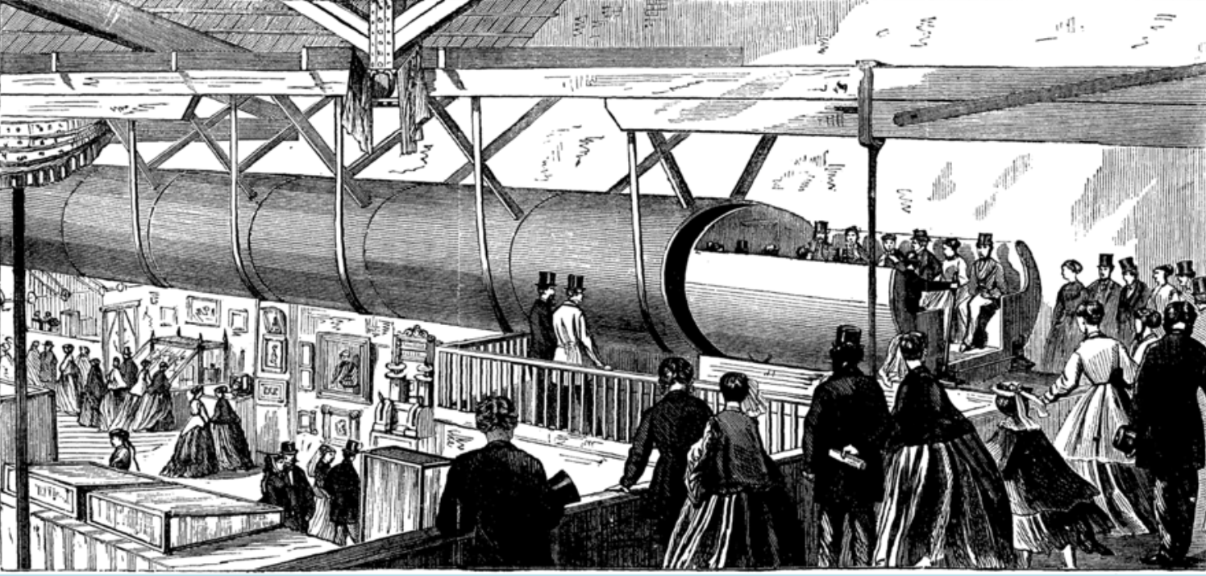
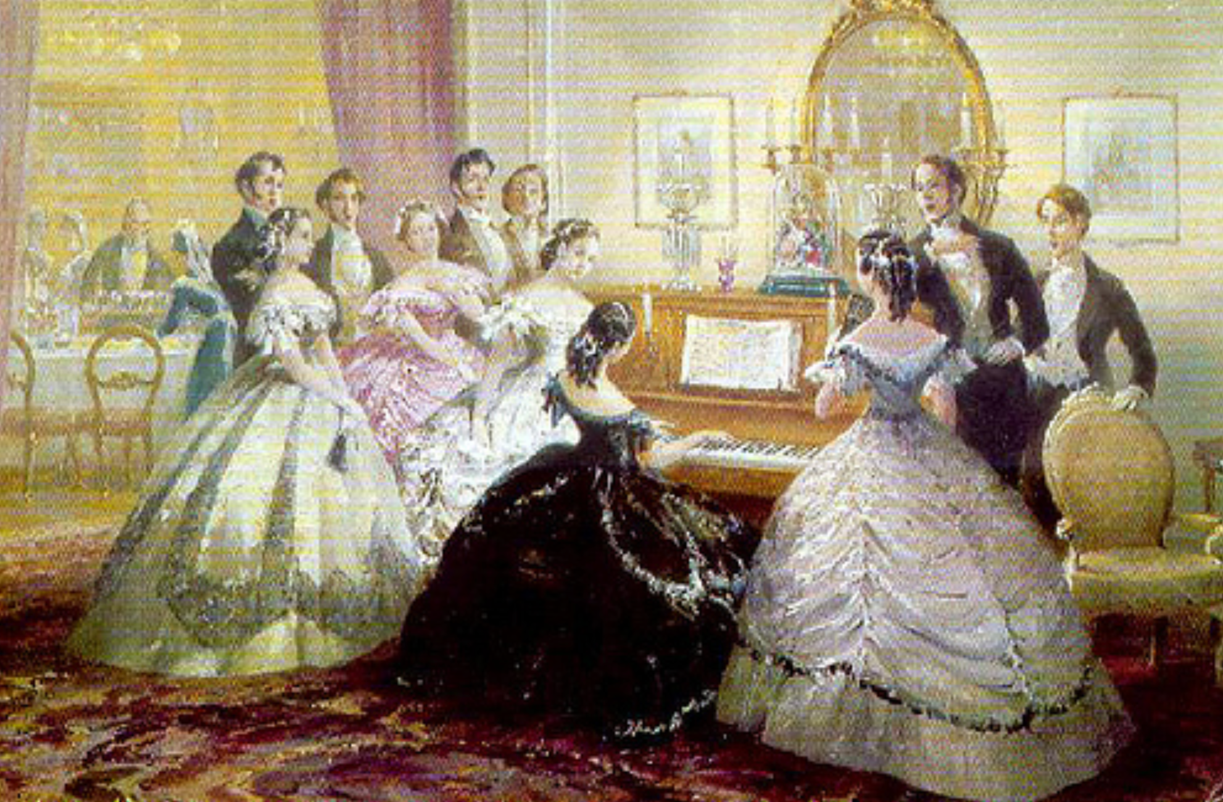
“The Limit of Human Felicity…”
After answering “yes” to the question “would you like to hear some music?” Bellamy’s protagonist is stupefied to find his hostess “merely touched one or two screws… and immediately the room was 'filled with music; filled, not flooded, for, by some means, the volume of melody had been perfectly graduated to the size of the apartment. “Grand!” I cried. ‘Bach must be at the keys of that organ; but where is the organ?’ (pp. 88-89) He learns that his hostess has called the orchestra on the telephone—for in Bellamy's utopia you can dial one of four orchestras, and then put it on the speakerphone.
Bellamy’s protagonist then says (p. 90): “If we [in the nineteenth century] could have devised an arrangement for providing everybody with music in their homes, perfect in quality, unlimited in quantity, suited to every mood, and beginning and ceasing at will, we should have considered the limit of human felicity already attained…"
To Edward Bellamy—a self-described utopian visionary, a late-nineteenth century minister’s son from western Massachusetts—a radio that could tune into any of four stations is “the limit of human felicity.”

Slide 11

Tower Records
What if someone were to take Edward Bellamy to Tower Records?
Ooops.
There is no Tower Records anymore, because they have been and are being eliminated by alternative and even cheaper and more efficient systems of distribution.
Well, if we could have taken Edward Bellamy to Tower Records when it existed, his heart would have stopped. Yet we do not think of our modern ability to cheaply listen to high-fidelity go-anywhere listen-to-anything music as a remarkable or even a notable part of our economy. We do not daily give thanks for our CD collections and genuflect in front of our iPods. We in the North Atlantic today do not reflect that we have been brought to “the limit of human felicity…”
But Edward Bellamy would think that we have…

Slide 12

Nordhaus, and Not Quite Among the 400
The argument that our commodity-focused price indices miss most of the real action—that price indices focusing on the services provided would produce vastly greater estimates of long-run economic growth—is made most powerfully by William Nordhaus (1996) in his study of the economic cost of light.
Nordhaus attempts to construct a consistent series of the real labor-time cost of illumination from the dawn of civilization until today. He concludes that the past hundred years have seen a ten thousand-fold decline in the real price of illumination. Yet the commodity-based price indices economists rely on have only captured a ten-fold decline in this real price. Nordhaus guesses that standard estimates understate “true” economic growth since 1800 by between 0.5% and 1.4% per year—an amount that cumulates to a multiplicative factor of between 3 and 15 over the past to centuries, and to a conclusion that real wages since 1900 have multiplied by a factor between 20 and 100.
Is this credible?
I have no problem at all with Nordhaus’s conclusion. My family’s income today is roughly $400,000 a year—about eight times median earnings per worker. Suppose that you stuffed me and my family into a time machine, sent us back a century to 1890, and then gave us an income equal to sixty-four times that of 1890 median per worker. We would not be among the 400 invited to the most exclusive parties in the mansions of Newport Rhode Island; but we would be among the next outer circle of 2,000 or so.
Would we then feel as rich as we feel now? Would we be happy—or at least not unhappy—with the switch?

Slide 13
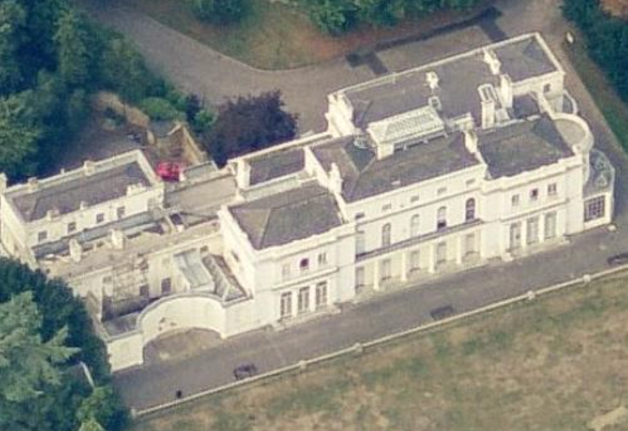
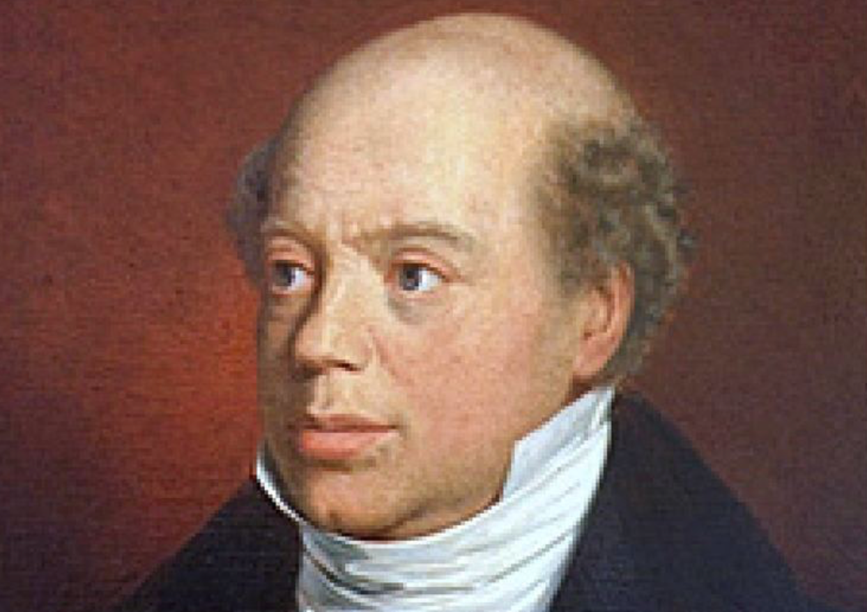
The Death of Nathan Meyer Rothschild
Our power to purchase some commodities would be vastly increased: we would have at least three live-in servants, a fifteen-room house (plus a summer place), if we lived in San Francisco we would live on Nob Hill, if we lived in Boston we would live on Beacon Hill, if we lived in New York we would live on Park or Fifth Avenue.
The answer is surely that we would not be happy and we would feel poor (although if you compared yourself to other people in 1890, you would feel very rich). I would want, first, health insurance: the ability to go to the doctor and be treated with late-twentieth-century medicines. Franklin Delano Roosevelt was crippled by polio. Nathan Meyer Rothschild—the richest man in the world in the first half of the nineteenth century—died of an infected abscess in his mid-fifties and never saw his grandchildren grow up. Without antibiotic and adrenaline shots I would now be dead of childhood pneumonia.

Slide 14
Questions About Nordhaus

Slide 15
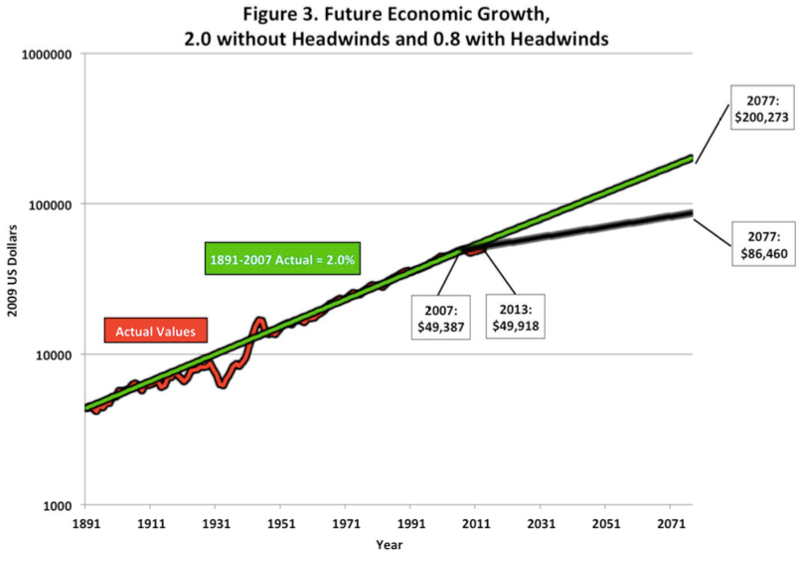
Reading Gordon
Robert Gordon (2000): Interpreting the “One Big Wave” in Long-Term Productivity Growth <https://www.nber.org/papers/w7752.pdf>:
Technological exhaustion occurred 40 years ago.
“There is no need to forecast that innovation in the future will ‘falter’…. The slowdown in the rate of productivity growth… occurred more than four decades ago….
“[My] forecast assumes that innovations in the next 40 years will be developed at the same pace as the last four decades, but reasons for skepticism are provided for that prediction….
“The… 1870 and 1900, with continuing benefits to 1972… “Second Industrial Revolution” (IR #2)…. growth rate of American productivity… [of] 2.36 percent per year, compared to 1.59 percent per year since 1972. That permanent decline of 0.8[%-points]… measure[s] the extent to which the single-dimension digital “Third Industrial Revolution” (IR #3) has fallen short of the multi-dimensional IR #2…

Slide 16
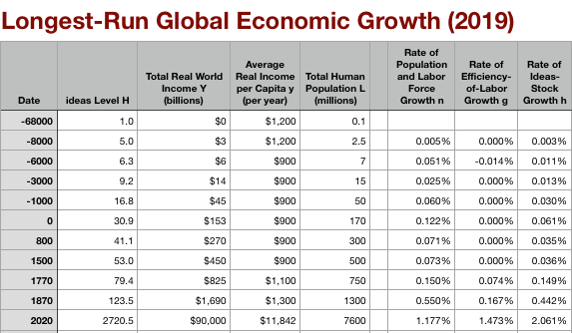
Global and “Western” Numbers
The Commercial Revolution acceleration appears everywhere
Due to globalization
And especially to the “Columbian Exchange”

Slide 17

“Western” Numbers
Is ‘the west’ special between 800 and 1500?
Or is it just recovery from a Dark Age depression?

Slide 18
Bob Gordon: The Eighty Years After 1880
In October, 1879, Thomas Edison created the first working electric light bulb…
Between 1890 and 1930 the American household became fully “networked,” replacing its previous isolation by five types of connections – electricity, gas, telephone, running water, and sewer pipes….
Two months after Edison’s electric light, Karl Benz achieved the first reliable and workable internal combustion engine…
An Englishman named David Edward Hughes succeeded in sending a wireless signal several hundred meters in London almost two decades before Marconi won his earliest wireless patents
At least three aspects of the Second Industrial Revolution have received less attention than they deserve… the multi-dimensional nature… everything happened all at once…. economic progress through 1972 mainly consisted of consolidating the incomplete aspects of IR #2 across many subsidiary and complementary inventions….
Two criteria help to capture the uniqueness of IR#2. First, something cannot be more than 100 percent…. The second … some indicators cannot go below zero…

Slide 19
Bob Gordon: Power and Matter Manipulation and Flush Toilets
Modern Economic Growth ain’t going to continue
It’s really all about:
Nonhuman combustion-based energy sources
Use of energy and automatic machinery for matter manipulation
Flush toilets
Everything else that is important is subject to Baumol’s disease
The Trachtenberg/Nordhaus counter…
The Varian counter…

Slide 20
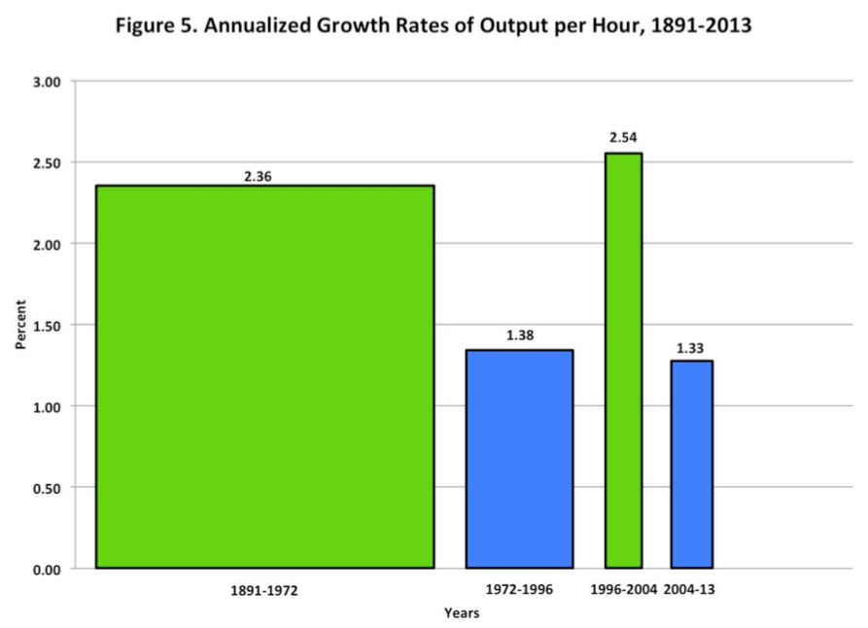
Bob Gordon: 1996-2004 a Flash in the Pan
Modern Economic Growth ain’t going to continue at its 1890-1972 pace
In what ways is 2004-13 unrepresentative of the future?
How would we figure out whether 1996-2004 or 1972-1996 is more likely going forward?

Slide 21
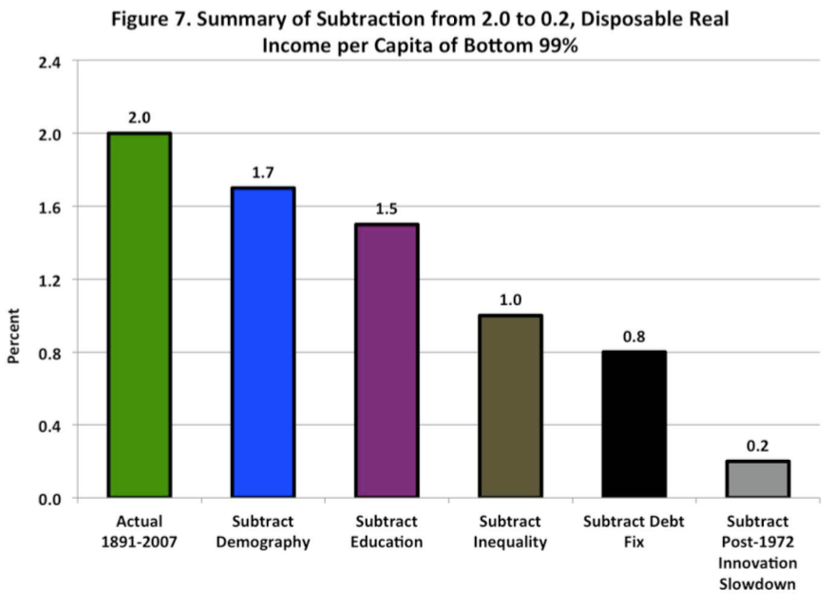
Bob Gordon: “Headwinds”
Modern Economic Growth ain’t going to continue at its 1890-1972 pace
Demography yes…
But education, inequality, “debt fix”?
Gordon is greatly widening his critique beyond the uniqueness of IR#2

Slide 22
Bob Gordon: The Next Forty Years
As we peer out into the future, the achievements of the past 40 years set a hurdle that is dauntingly high.
The achievements that must be matched for importance in the next four decades include:
Memory typewriters, the personal computer, word-processing and spreadsheets
Bar-code scanning, ATM banking, cable and satellite TV
Internet, e-mail, web browsing, e-commerce
Google, Amazon, Wikipedia, Linked-In, Facebook
Mobile phones, smart phones, ipads
CDs, DVDs, i-tunes, Netflix, movie streaming
Airline reservation systems, supply-chain monitoring systems, electronic library catalogs
What is in store for the next 40 years?

Slide 23
Questions About Gordon

Slide 24
Assignment Next Time: Unfreedom
What relevance and use does a work like Karl Marx and Friedrich Engels (1848), "Manifesto of the Communist Party" have to twenty-first century economists today?
Readings:
Karl Marx and Friedrich Engels (1848): Manifesto of the Communist Party <http://www.marxists.org/archive/marx/works/1848/communist-manifesto/>
Stanley Engerman and Kenneth Sokoloff (1994): Factor Endowments, Institutions and Differential Paths of Development among New World Economies <http://papers.nber.org/papers/h0066>
Nathan Nunn (2008): The Long-Term Effects of Africa’s Slave Trades <http://www.jstor.org/stable/pdfplus/25098896.pdf>

Slide 25
Catch Our Breath…
Ask a couple of questions?
Make a couple of comments?
Any more readings to recommend?

Slide 26
Notes…

Slide 27
Reading Thompson
Peter Thompson (2001): How Much Did the Liberty Shipbuilders Learn? New Evidence for an Old Case Study <http://www.jstor.org/stable/pdfplus/10.1086/318605.pdf>:
“The inclusion of the capital investment data diminishes the importance of learning. Without capital data, a ceteris paribus doubling of cumulative output is estimated to increase monthly output by 41 percent; the inclusion of capital reduces this estimate to about 22 percent…”
“Quality…productivity mismeasurement… induces mismeasurement equivalent to only about 5 percent of observed productivity growth…”

Slide 28
Emergency Shipbuilding Program
Liberty ship, an all-welded cargo ship with a displacement of 7,000 tons
16 U.S. shipyards delivered a total of 2,699 ships
A substantial portion of ship construction undertaken “off the ways”
600,000 feet of welded joints
Welding labor accounted for about one-third of direct labor
Lots of new welders…
A cadre, and—some—managers with experience. Otherwise…

Slide 29
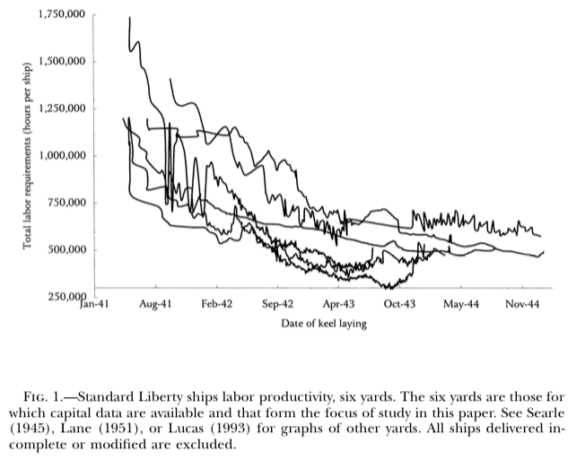
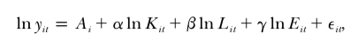
Data: Labor
1,000,000 hours per ship in the middle of 1941…
Falling to 300,000-700,000 hours pe r ship by the middle of 1943
And there it plateaus
What kind of production function would one want to fit here?

Slide 30
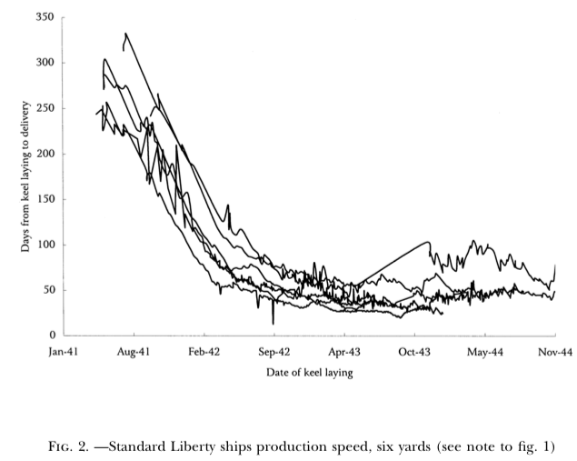
Data: Time
Time—sequencing of production—is also an input into the production process
Ships built in a short time are using capital very intensively indeed…
Learning how to use capital more intensively?
Diseconomizing on labor so that you can use the capital more intensively?

Slide 31
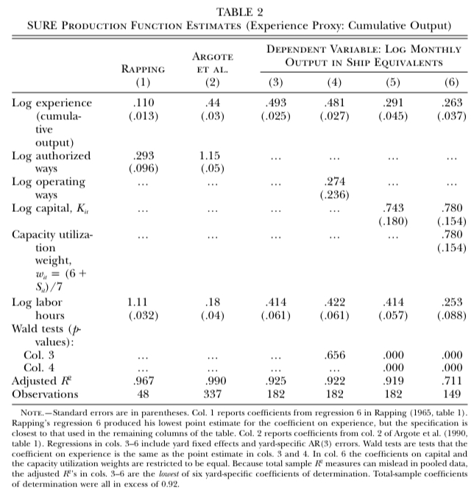
Results
0.291…
“Cumulative capital investment and experience are highly correlated, so that separating their effects reliably is difficult…”
“It does seem reasonable to draw one conclusion from the Liberty ship program that is likely to resonate elsewhere: in a case study that is widely viewed as one of the cleanest examples of learning by doing on record, the real causes of productivity growth have turned out to be more complex and more diverse than economists have long believed to be the case…”
WTF?!

